Slide 1
SERVERLESS INTERNET OF THINGS
Team Members: Harish S
Vignesh N
Premkumar M
Ruknu Roshan M

Slide 2
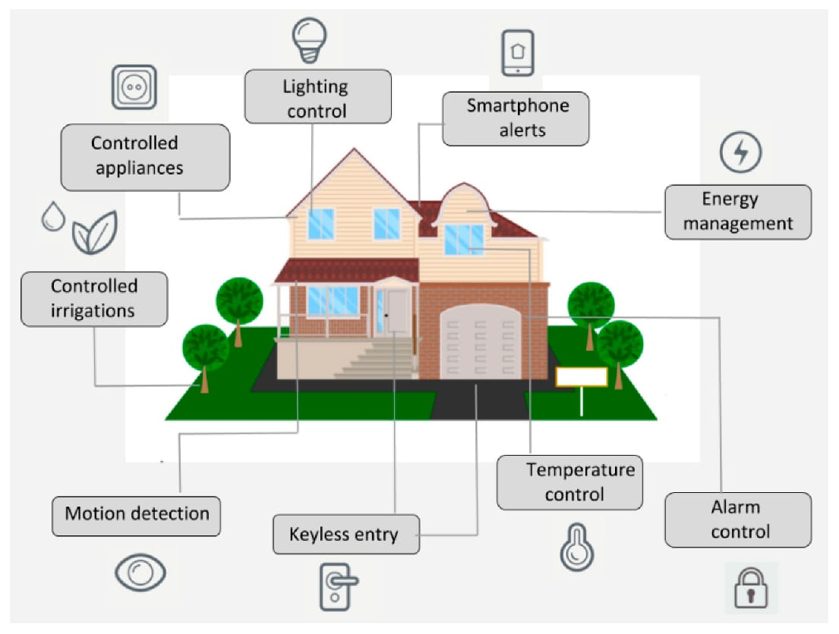
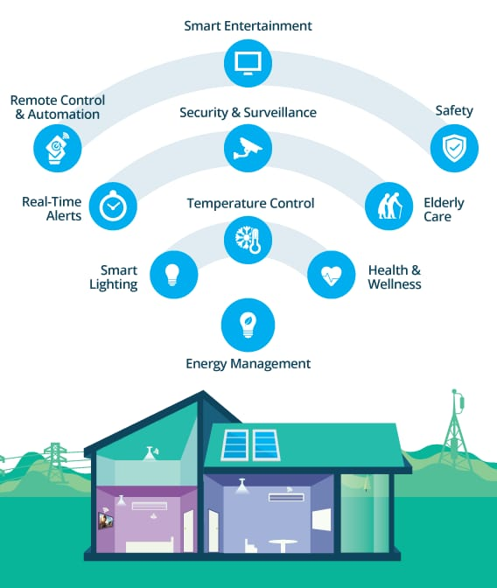
DATA INTEGRATION

Slide 3
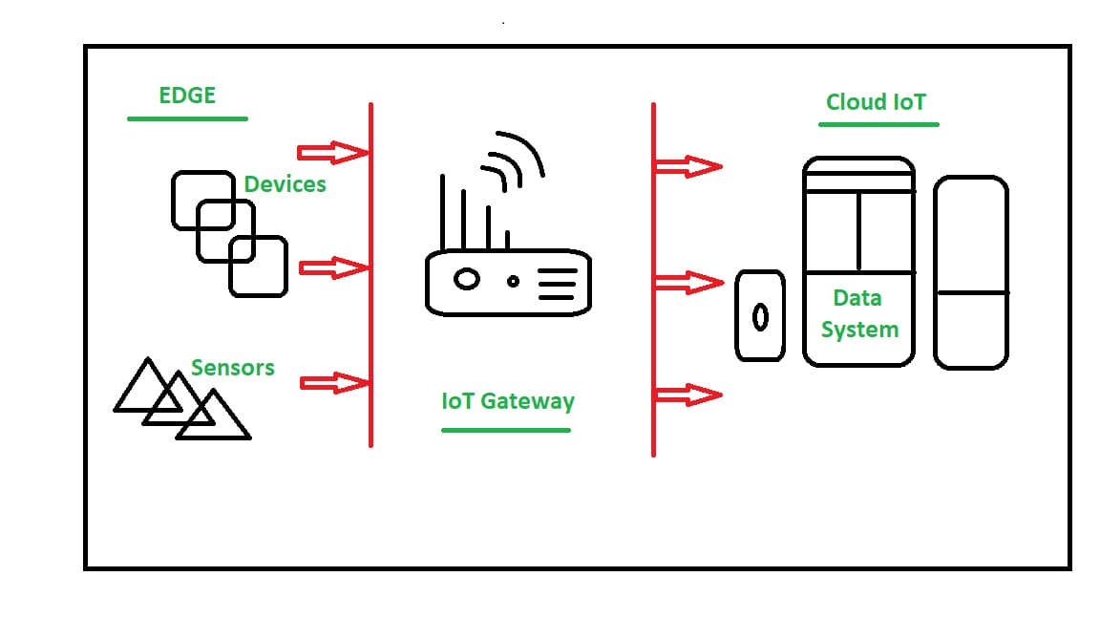
DATA COLLECTION

Slide 4
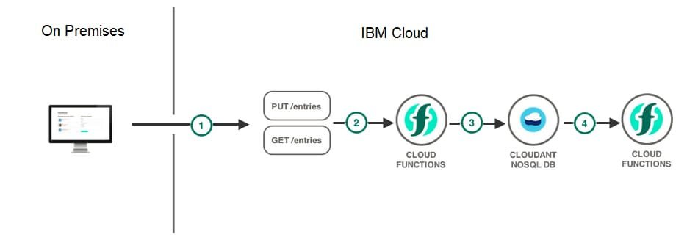
REAL TIME PROCESSING

Slide 5
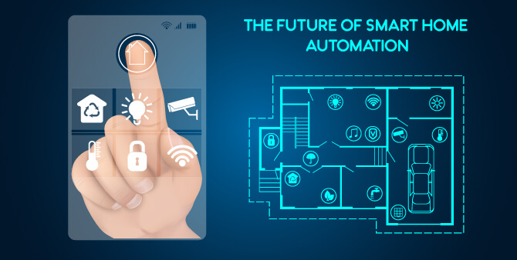
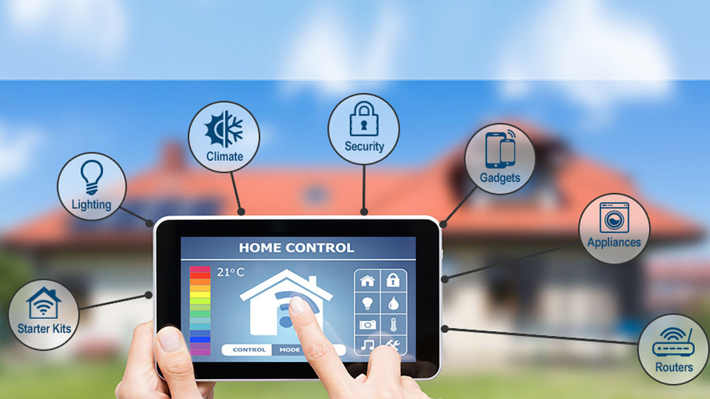
AUTOMATION

Slide 6
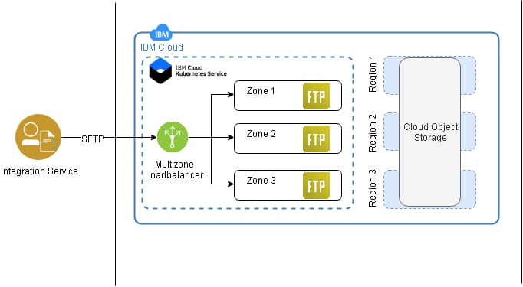
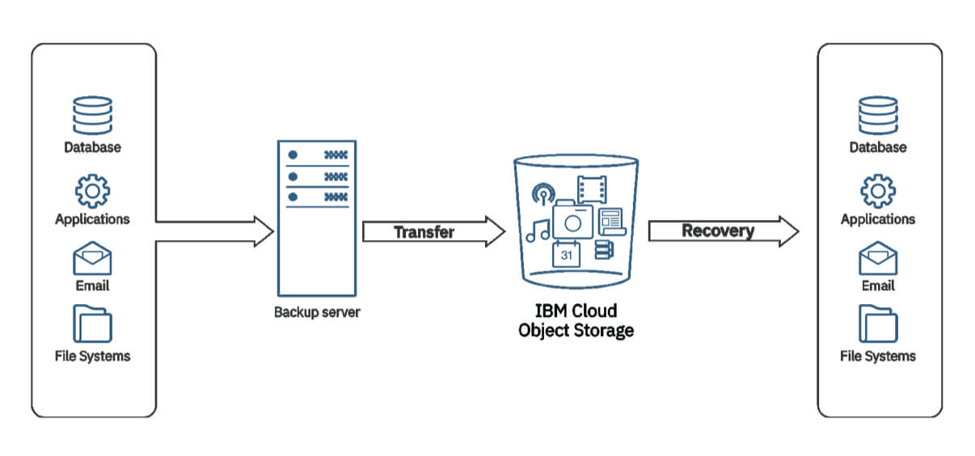
STORAGE AND ANALYSIS

